Slide 1


Slide 2
CSC 236
Tutorial Number 9 - Daniel Razavi

Slide 3
Today’s Problem Set

Slide 4


Slide 5
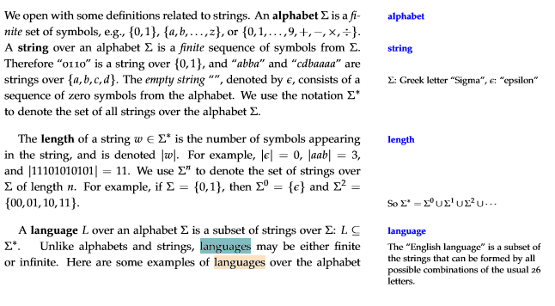
Let’s remind everyone a little context...
notes.pdf

Slide 6

My example:
We can say that the language that satisfies this property:
the empty language L = {}
Or you can also say
the language M = {epsilon}.
We have L* = M* = {epsilon}.

Slide 7


Slide 8
Simply speaking, any string from this language has to end with the end with 0 and has to be equal to or larger than 2.
This is the same as asking for a regex whose strings all end with 0:
(0|1)*0 ← this is the regex

Slide 9
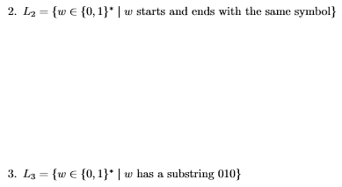

Slide 10
Similar to part 1, using regex we can say:
(0(0|1)*0) | (1(0|1)*1) | 0 |1 | ε
The last piece captures the empty string.
The first piece recognizes strings that start and end with 0;
The third and fourth pieces recognize 0 and 1.
the second piece recognizes strings that start and end with 1.

Slide 12
Similar to part 1 and 2, using regex we can say:
(0|1)* 010 (0|1)*

Slide 13
Let’s Talk About that Midterm...

Slide 14
Midterms are finally marked
Class Average of 62%

Slide 15
Let’s Go Over the Midterm Solutions

Slide 16
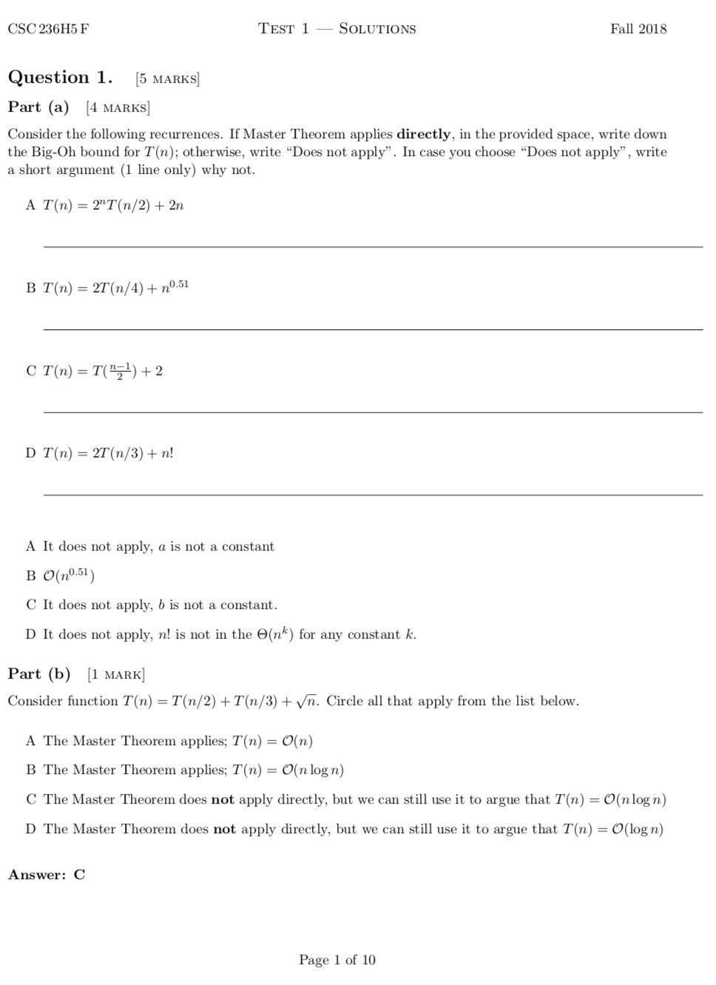

Slide 18
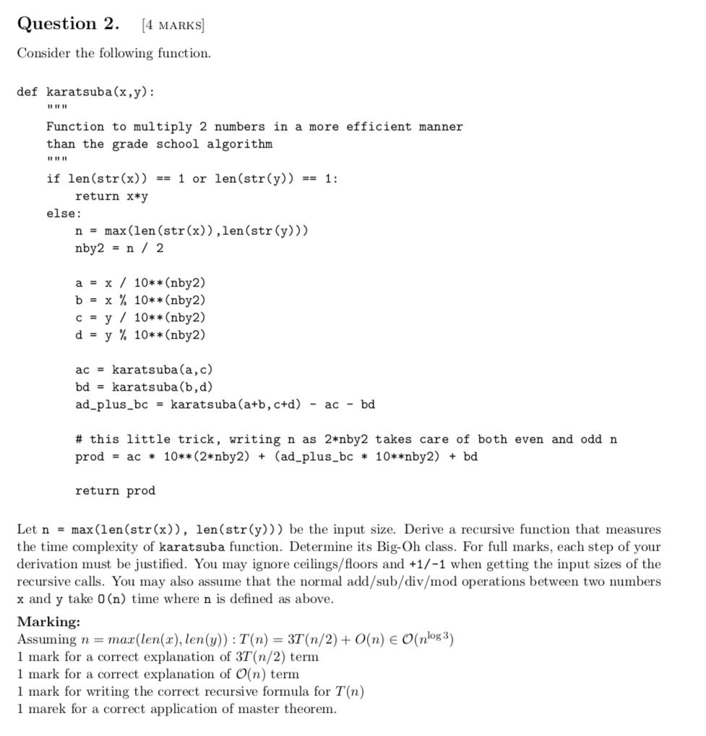

Slide 19
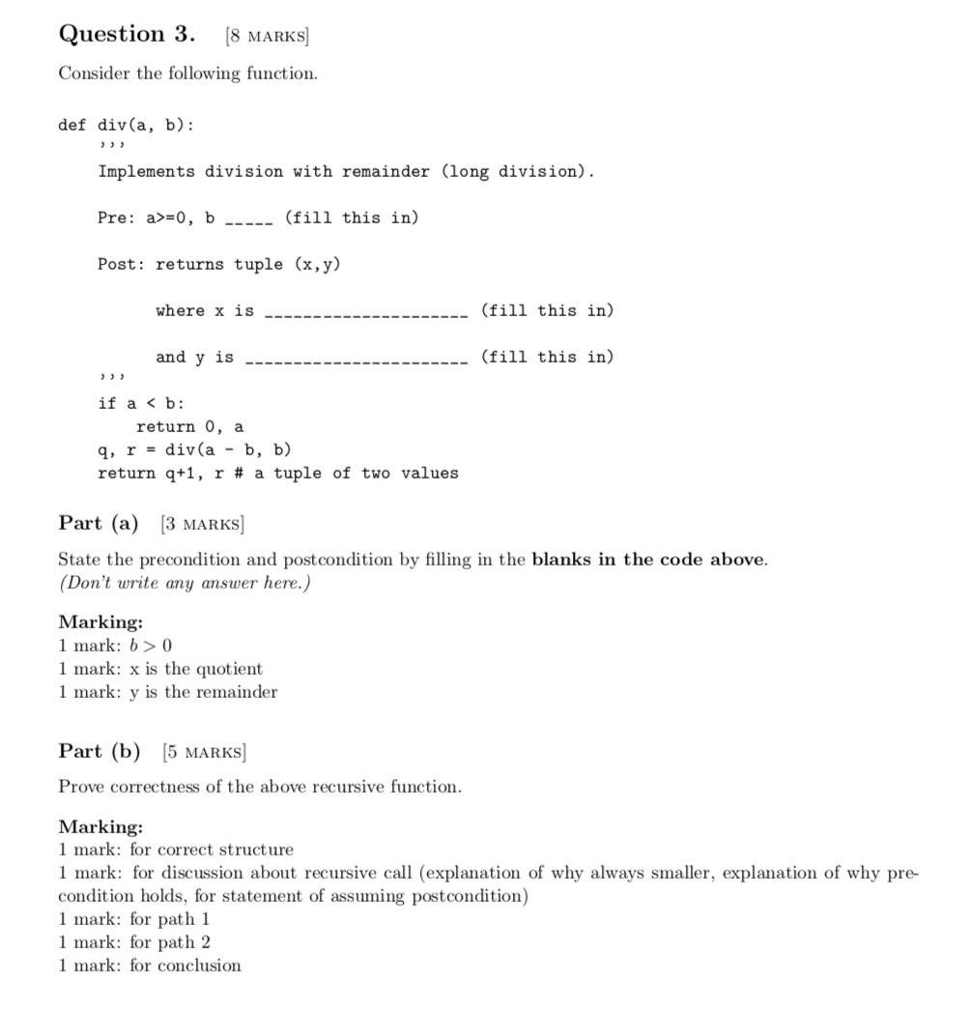

Slide 20
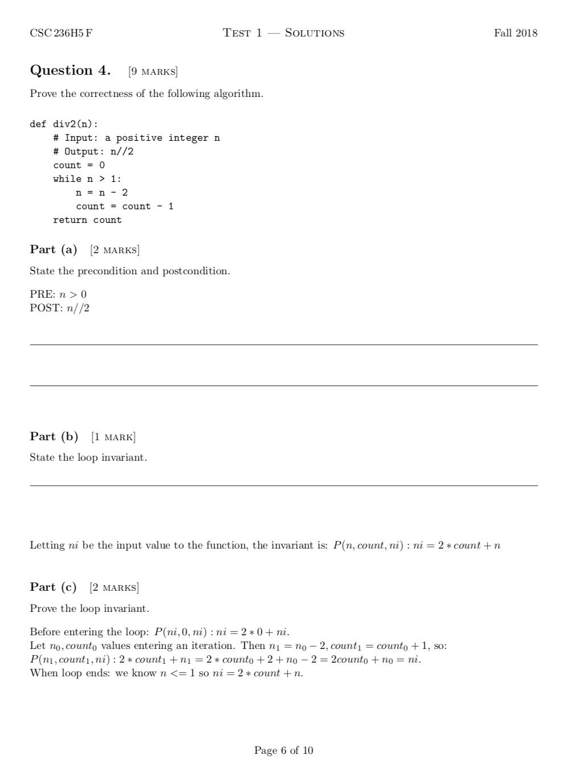

Slide 23
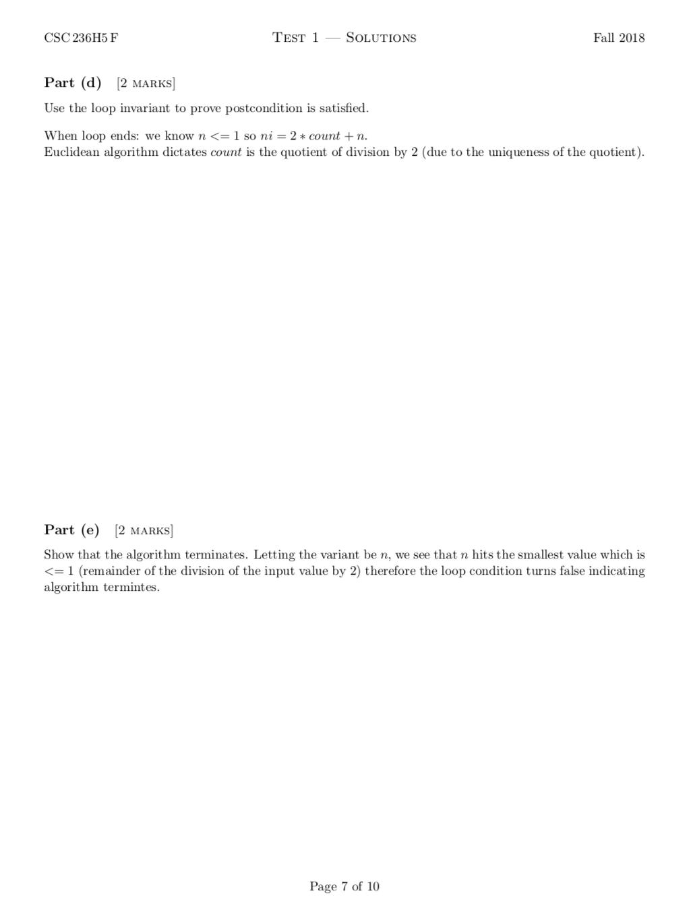

Slide 25
CSC 236
Tutorial Number 9 - Daniel Razavi

